Slide 1

6th Grade Accelerated Math
Unit 12, Lesson 4 Discounts and Markups Volume 2, pg. 228

Slide 2


Benchmark
MA.7.AR.3.1
Apply previous understanding of percentages and ratios to solve multi-step, real-world percent problems.
volume 2, pg. 228

Slide 3
Integrated Mathematical Thinking and Reasoning Standards
MA.K12.MTR.5.1 Use patterns and structure to help understand and connect mathematical concepts.
MA.K12.MTR.6.1 Assess the reasonableness of solutions.
MA.K12.MTR.7.1 Apply mathematics to real-world contexts.
volume 2, pg. 228

Slide 4

Learning Target
I can solve problems involving discounts and markups.
volume 2, pg. 228

Slide 5

Warm-Up
volume 2, pg. 229

Slide 6
12.4.1 Warm-Up: Civil Engineer
Alishia Ballard works as a civil engineer for San Francisco Public Works. Civil engineers work on the plans to create structures such as bridges, large buildings, etc. They also analyze whether or not structures are safe.
How do you think civil engineers use math in their tasks?
Alishia enjoys working at Public Works because it’s a way to give back to her community. Every structure plan she works on or structure she inspects is all for the people around her.
What is something you have done that gives back to your community, your school, or your peers?
volume 2, pg. 229

Slide 7

Guided Instruction
volume 2, pg. 229

Slide 8
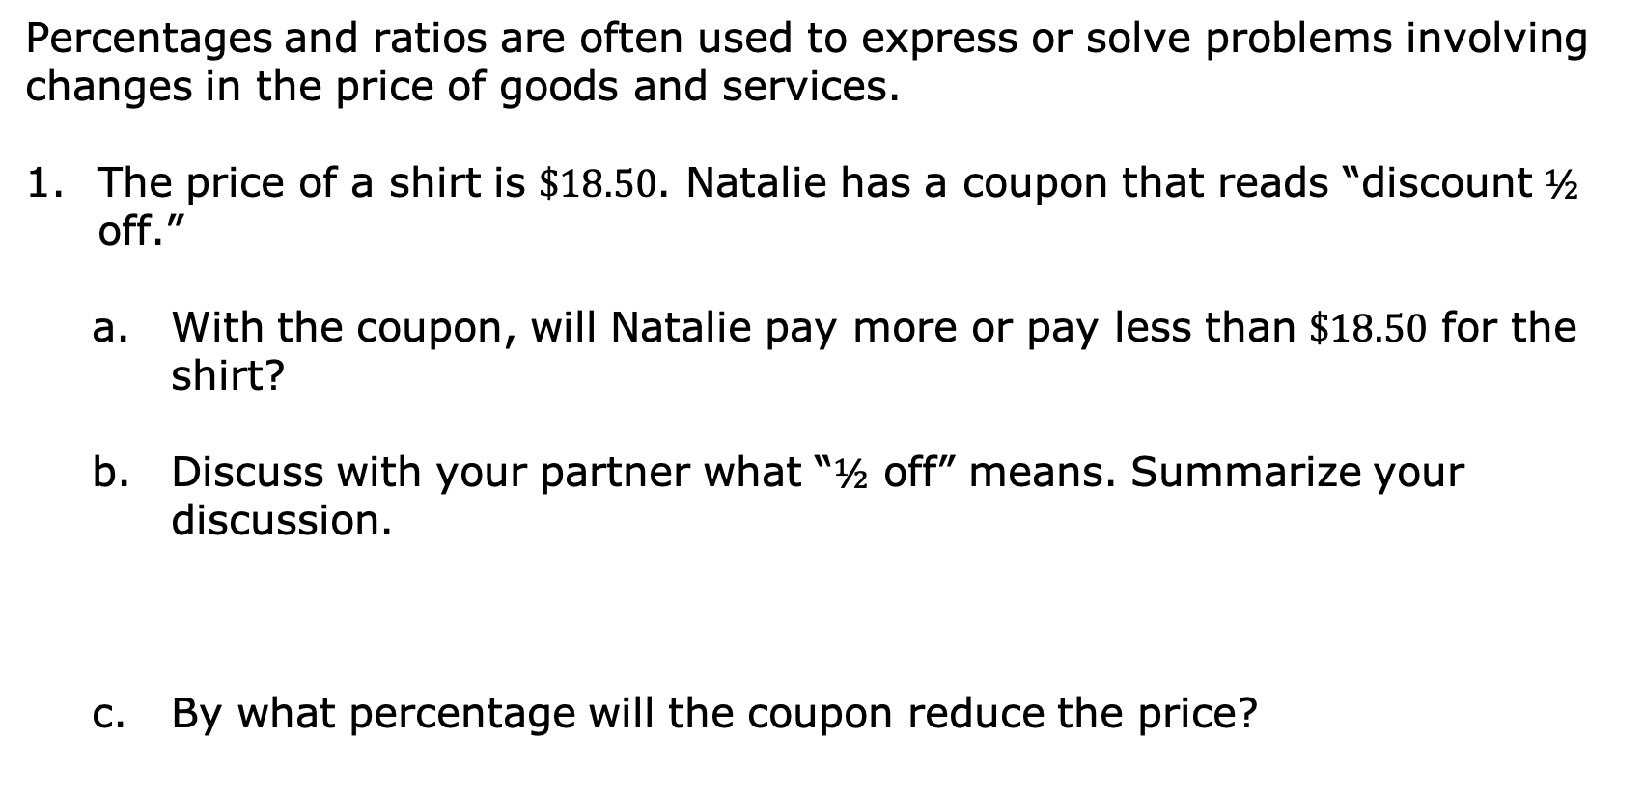
12.4.2 Guided Instruction: Discounts and Markup
Percentages and ratios are often used to express or solve problems involving changes in the price of goods and services.
The price of a shirt is $\$18.50$. Natalie has a coupon that reads “discount $½$ off.”
With the coupon, will Natalie pay more or pay less than $\$18.50$ for the shirt?
Discuss with your partner what “$½$ off” means. Summarize your discussion.
By what percentage will the coupon reduce the price?
A discount is a reduction of a price for goods or services.
volume 2, pg. 229

Slide 9
What is the discount amount, in dollars, taken off the shirt price?
What is the discounted price, in dollars, of the shirt after the coupon is applied?
volume 2, pg. 230

Slide 10
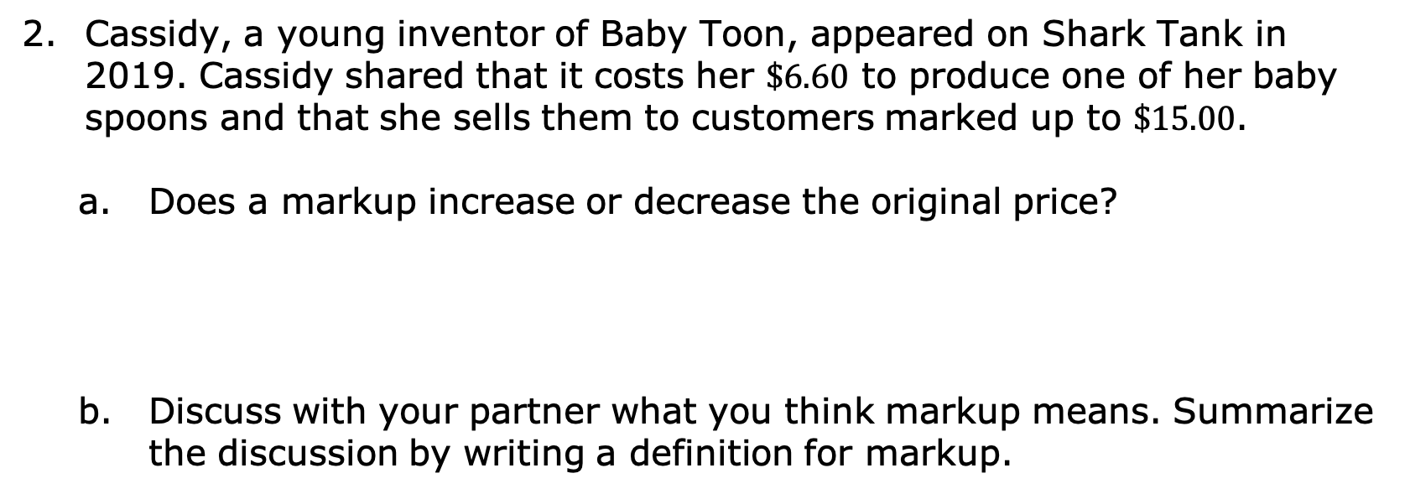
Cassidy, a young inventor of Baby Toon, appeared on Shark Tank in 2019. Cassidy shared that it costs her $\$6.60$ to produce one of her baby spoons and that she sells them to customers marked up to $\$15.00$.
Does a markup increase or decrease the original price?
Discuss with your partner what you think markup means. Summarize the discussion by writing a definition for markup.
volume 2, pg. 230

Slide 11
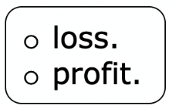
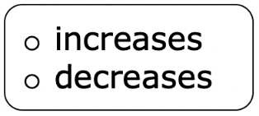
Complete the statements.
A markup is applied to goods or services so that the
seller is able to make a The markup
the price from the cost to the seller and
is usually determined using percentages.
volume 2, pg. 230

Slide 12
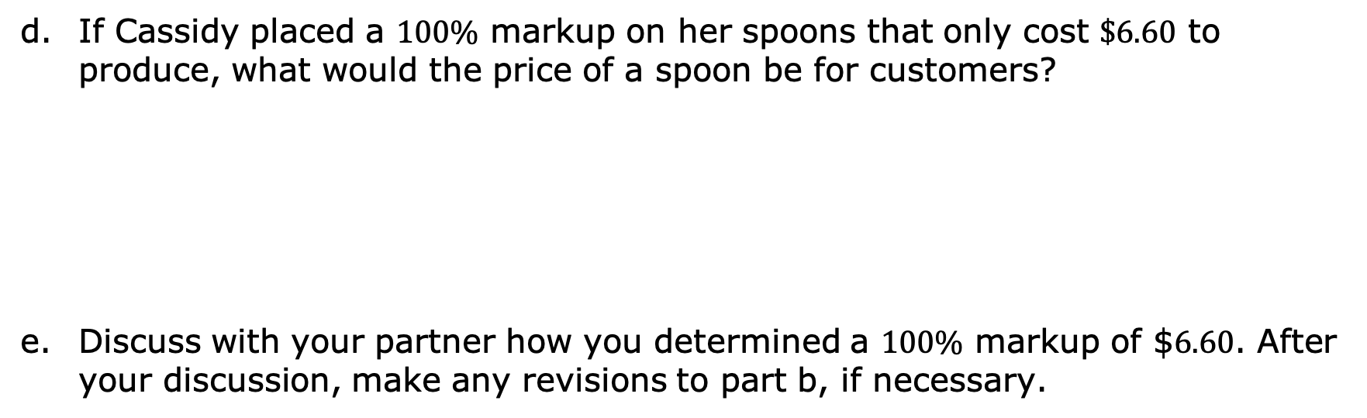
If Cassidy placed a $100\%$ markup on her spoons that only cost $\$6.60$ to produce, what would the price of a spoon be for customers?
Discuss with your partner how you determined a $100\%$ markup of $$6.60$. After your discussion, make any revisions to part b, if necessary.
volume 2, pg. 230

Slide 13
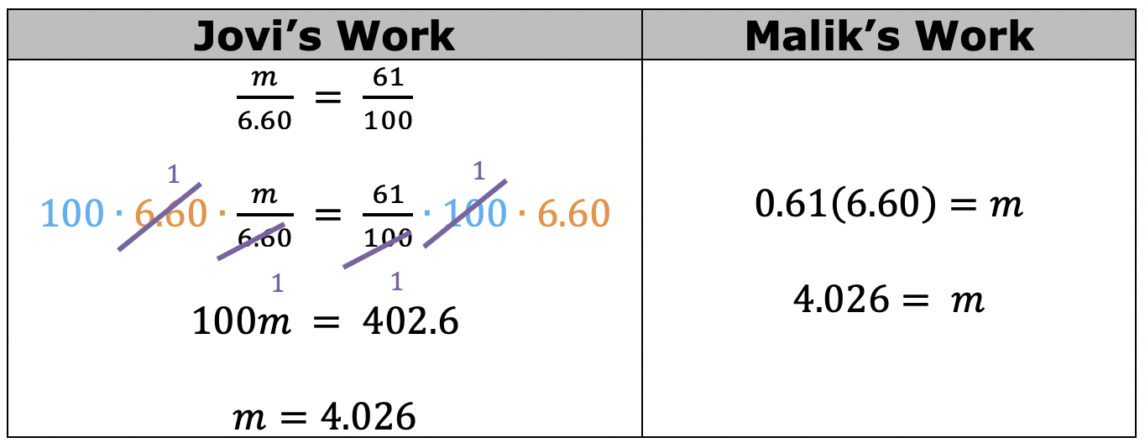
Jovi and Malik used two different methods to find the price of the spoon if the markup used is $61\%$. Part of their work is shown.
volume 2, pg. 231

Slide 14
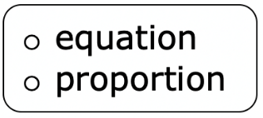
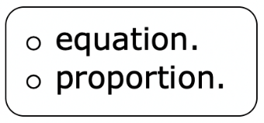
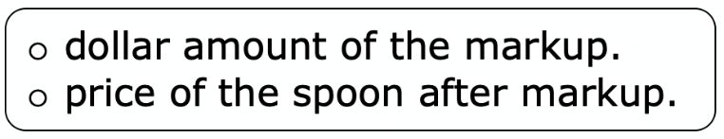
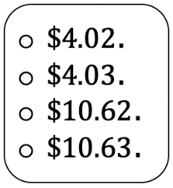
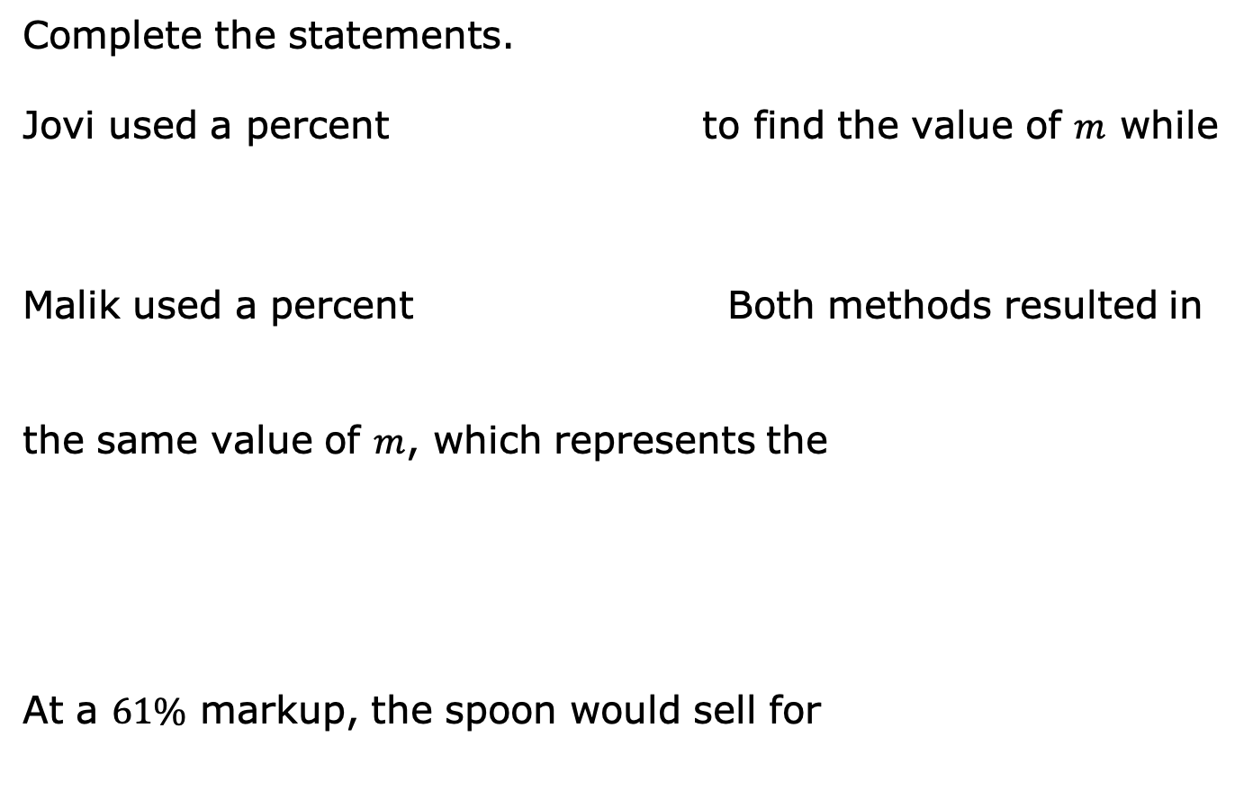
Complete the statements.
Jovi used a percent to find the value of $m$ while
Malik used a percent Both methods resulted in
the same value of $m$, which represents the
At a $61\%$ markup, the spoon would sell for
volume 2, pg. 231

Slide 15
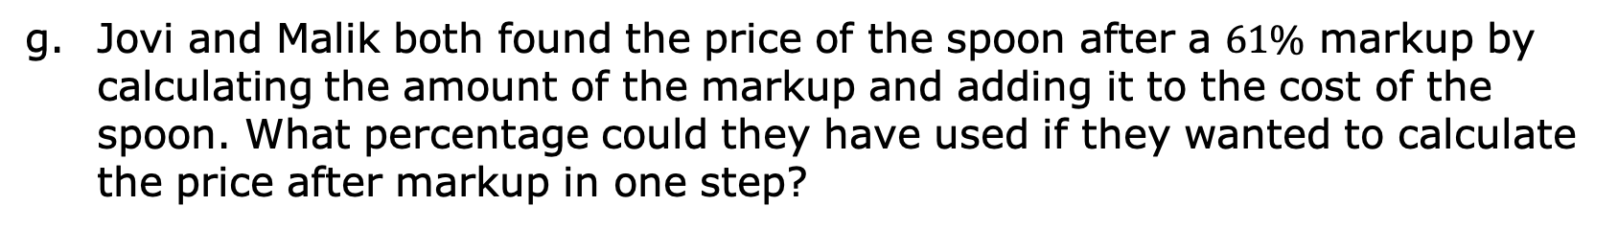
Jovi and Malik both found the price of the spoon after a $61\%$ markup by calculating the amount of the markup and adding it to the cost of the spoon. What percentage could they have used if they wanted to calculate the price after markup in one step?
volume 2, pg. 231

Slide 16

Activity
volume 2, pg. 232

Slide 17

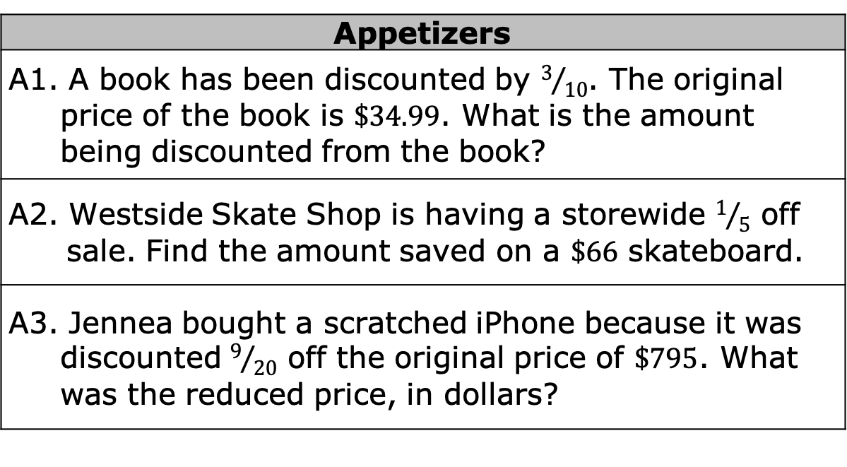
12.4.3 Activity: Math Menu
With your partner, choose your meal from the math menu shown. Select one appetizer, one main course, two side dishes, and one dessert. Put a * next to your selections. Then, solve each problem selected.
Appetizers
A1. A book has been discounted by $3/{10}$. The original price of the book is $\$34.99$. What is the amount being discounted from the book?
A2. Westside Skate Shop is having a storewide $1/5$ off sale. Find the amount saved on a $\$66$ skateboard.
A3. Jennea bought a scratched iPhone because it was discounted $9/{20}$ off the original price of $\$795$. What was the reduced price, in dollars?
volume 2, pg. 232

Slide 18
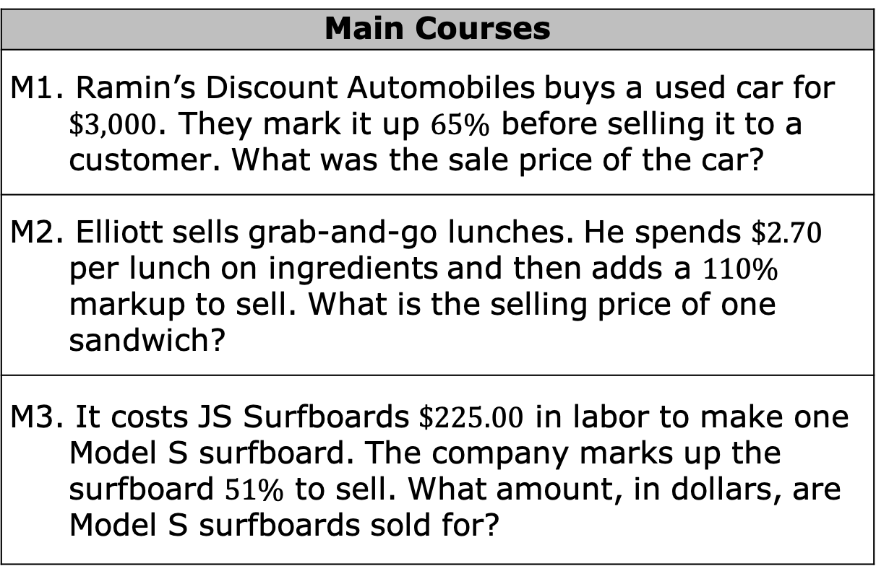
Main Courses
M1. Ramin’s Discount Automobiles buys a used car for $\$3,000$. They mark it up $65\%$ before selling it to a customer. What was the sale price of the car?
M2. Elliott sells grab-and-go lunches. He spends $\$2.70$ per lunch on ingredients and then adds a $110\%$ markup to sell. What is the selling price of one sandwich?
M3. It costs JS Surfboards $\$225.00$ in labor to make one Model S surfboard. The company marks up the surfboard $51\%$ to sell. What amount, in dollars, are Model S surfboards sold for?
volume 2, pg. 232

Slide 19
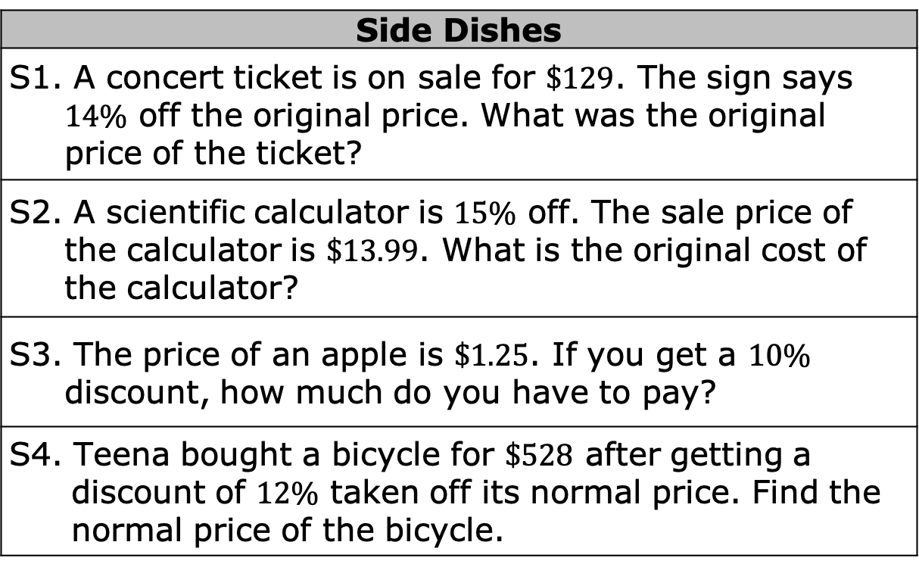
Side Dishes
S1. A concert ticket is on sale for $\$129$. The sign says $14\%$ off the original price. What was the original price of the ticket?
S2. A scientific calculator is $15\%$ off. The sale price of the calculator is $\$13.99$. What is the original cost of the calculator?
S3. The price of an apple is $\$1.25$. If you get a $10\%$ discount, how much do you have to pay?
S4. Teena bought a bicycle for $\$528$ after getting a discount of $12\%$ taken off its normal price. Find the normal price of the bicycle.
volume 2, pg. 232

Slide 20
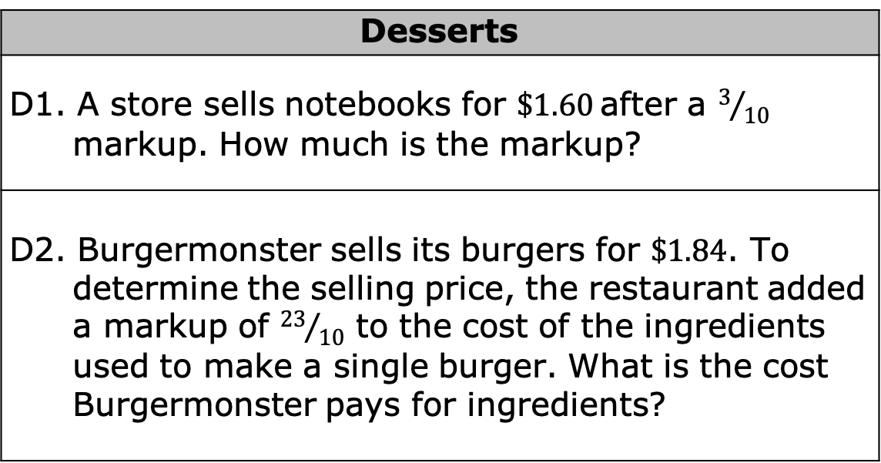
Desserts
D1. A store sells notebooks for $\$1.60$after a $3/{10}$ markup. How much is the markup?
D2. Burgermonster sells its burgers for $\$1.84$. To determine the selling price, the restaurant added a markup of ${23}/{10}$ to the cost of the ingredients used to make a single burger. What is the cost Burgermonster pays for ingredients?
volume 2, pg. 232

Slide 21
Appetizer Selection Work and Answer
Main Course Selection Work and Answer
volume 2, pg. 233

Slide 22
Side Dish Selection Work and Answers
Dessert Selection Work and Answers
volume 2, pg. 233

Slide 23

Wrap-Up
volume 2, pg. 234

Slide 24

12.4.4 Wrap-Up: Reflection
What was the muddiest (most difficult or confusing) point in today’s lesson on discounts and markup?
volume 2, pg. 234

